Slide 1

Property Valuation Model
Predicting the sale price for homes in Ames, Iowa

Slide 2
What is a Property Valuation Model (PVM)?
Why is PVM Important?
This is a model used within some type of application-based tool that aims to estimate property value, usually given property characteristics and other factors that relate to market value.
Knowledge
Time
Processes
Provide buyers and sellers with a reasonable estimation for what the home is valued at and/or likely to sell for.
The time it takes to get an estimate via traditional processes vs. AVM cannot be understated.
While initially used to estimate residential real estate value, these models are now supporting underwriting decisions for consumer loans

Slide 3
You May Know…
01
02
Freddie Mac & Equifax
Zillow & Trulia
(Commercial AVM Providers)
(Free AVM Provider)

Slide 4
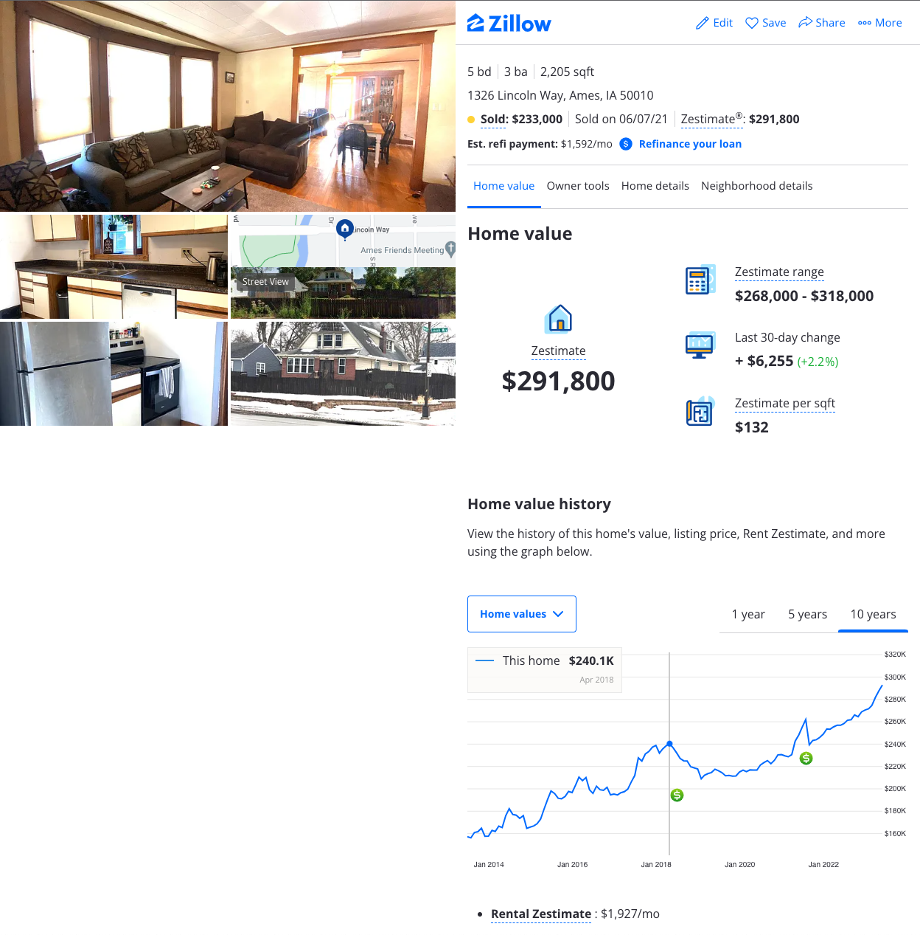
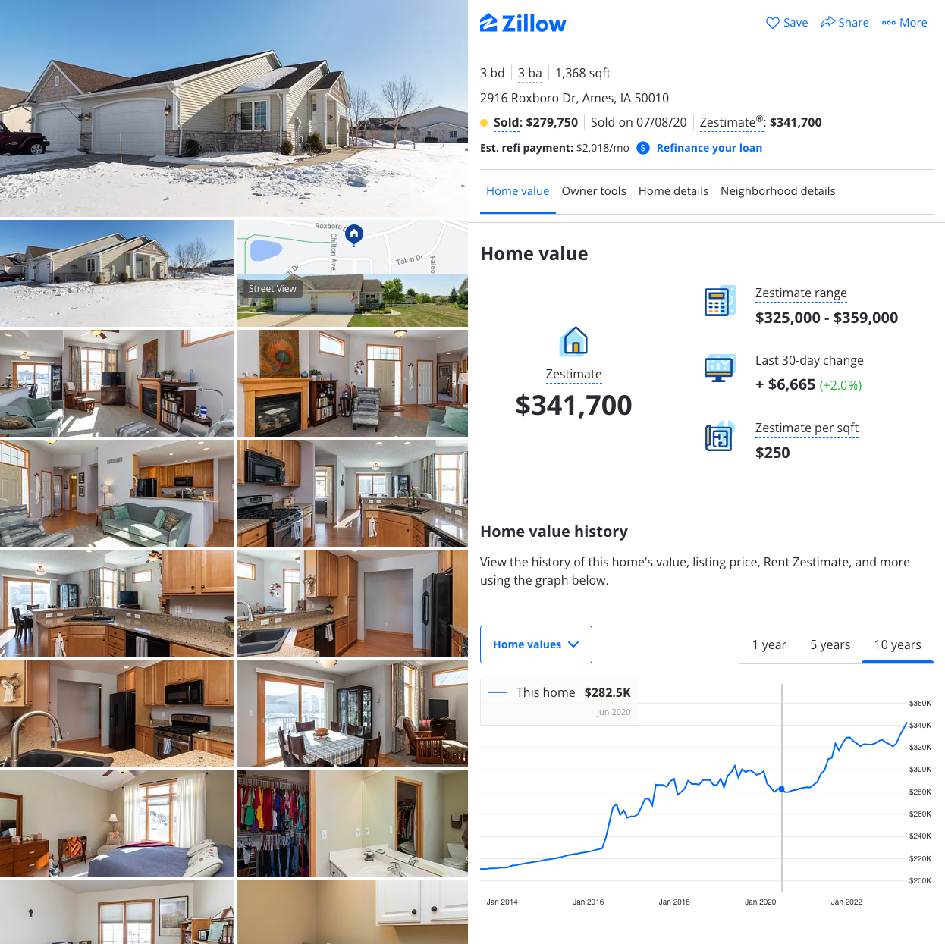
Can this PVM Compete With the Most Popular Free AVM (Zillow) on the Market?
$199.8K
$279.9K
$200K
$279.7K

Slide 5
What is a Zestimate?
A Zestimate valuation is a proprietary Zillow tool for getting a free, instant estimate of a home’s market value. The Zestimate is calculated through a Zillow algorithm that crunches data from public property records, tax records, recent home sales in the area, and user-submitted information to come up with an approximate market value for a home.*
The Zestimate takes into account:
Home details like square footage, location and the number of bedrooms and bathrooms.
On-market data such as listing price, description, comparable homes in the area and days on the market.
Off-market data such as tax assessments, prior sales and other publicly available records
Market trends, such as seasonal changes in demand.
*https://www.zillow.com/sellers-guide/influencing-your-zestimate/

Slide 6
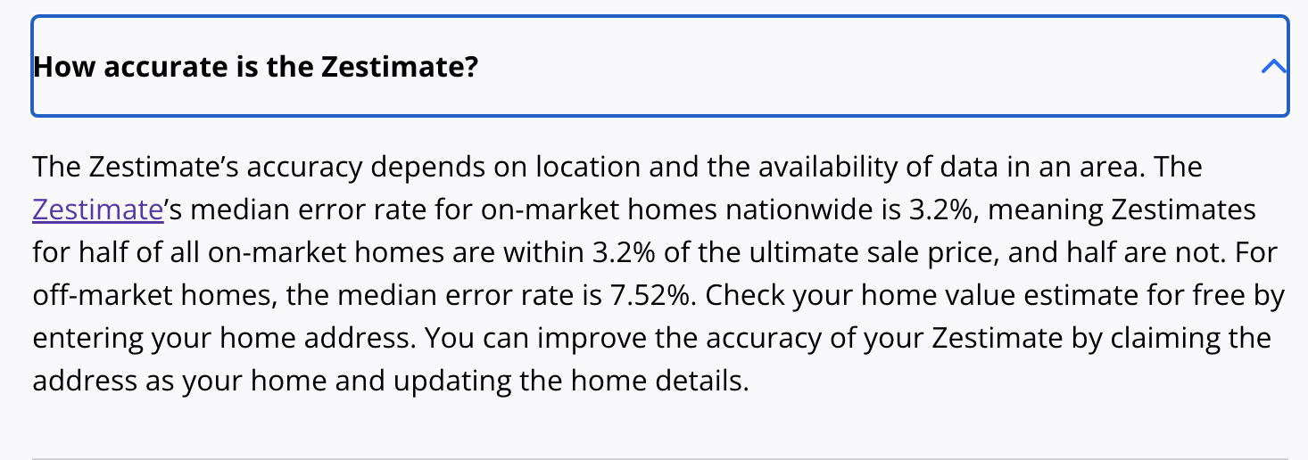
A Note on Zestimate Accuracy?*
*https://www.zillow.com/how-much-is-my-home-worth/

Slide 7
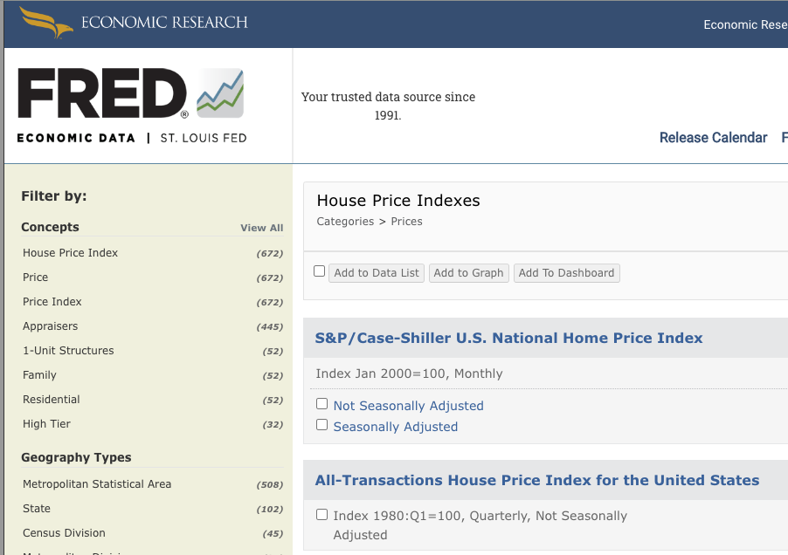
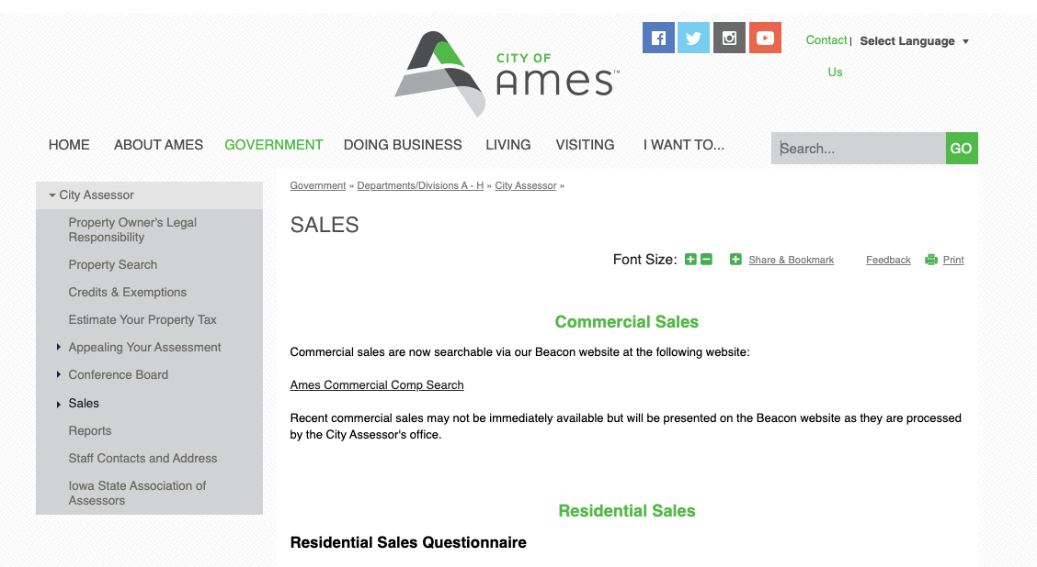
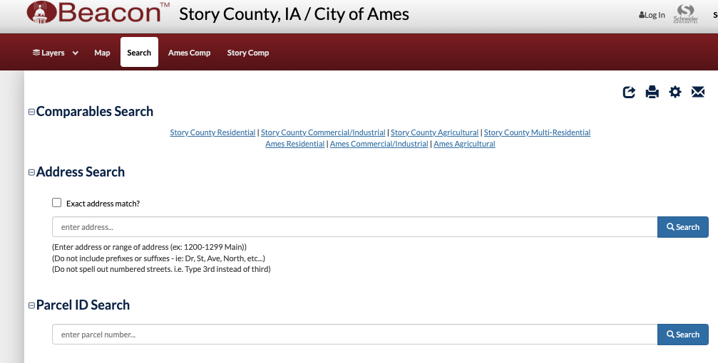

Data Sources

Slide 8
Data Sources
 | Source | Description | Value
1 | City of Ames, Assessor Government Site | Property Tax Records - Assessment Reports | Core Dataset → provides sale and property data
2 | City of Ames, Assessor Government Site | Data Dictionary | Understanding the data
3 | Federal Reserve Economic Data (FRED) | HPI | Helps control for seasonality
4 | Zillow | Property zestimates over time, historical sale data | Property zestimates over time, historical sale data
5 | Story County, IA/City of Ames/IA - Parcel Search Database | Provides property tax data and detailed sale data | PP30 Deep Dive

Slide 9
Feature Space
MapRefNo | GeoRefNo | Tier | Range | Prop_Addr | ZngCdPr | ZngCdSc | ZngOLPR | ClassPr_s | Legal_pr
SchD_S | TxD_S | MA_Ownr1 | MA_Ownr2 | MA_Line1 | MA_Line2 | MA_City | MA_State | MA_Zip1 | MA_Zip2
Rcrd_Yr | Rcrd_Mo | Inst1_No | Inst1_Yr | Inst1_Mo | Inst1TPr | LndAc_S | ImpAc_S | OthAc_S | TtlVal_AsrYr
ValType | X1TPr_D | X1TSc_D | X2TPr_D | X2TSc_D | X1TPr_S | X1TSc_S | X2TPr_S | X2TSc_S | LndAcX1S
ImpAcX1S | ImpAcX2S | HSTtl_D | MilVal_D | HSTtl_S | MilVal_S | AcreX_S1 | AcreGr | AcreNt_S | Neighborhood
LotArea | ParType | BldgNo_S | DwlgNo_S | BldgType | YrBuilt | HouseStyle | Foundation | RoofMatl | Ext1
Ext2 | MasVnrType | Heating | Central Air | GLA | TtlBsmtSF | TotRmsAbvGrd | Fireplaces | PoolArea | GarageType
GarYrBlt | Cars | GarageArea | YrSold_YYYY | MoSold_MM | SalePrice | SaleType | SaleCond | ParclRel | PA-Nmbr
PA-PreD | PA-Strt | PA-StSfx | PA-PostD | PA-UnTyp | PA-UntNo | Date | Source | NmbrBRs | ClassSc_S
ZngOLSc

Slide 10
Cleaning & Preprocessing
General Rule: > 10%
Augment the Data
Exploratory Data Analysis
Explore the +- 2.5% Target Values
Train Test Split
The dataset has 4,181 observations (Homes sold within the past 18-24 months) and 92 features. The data dictionary provided by the city website was vital to understanding the features.
Eliminate features that have more than 10% missing values. Here all features that were eliminated by this had > 50% missing values
Add HPI: A quarterly index that measures that average price change in repeat sales or refinancing on the same properties
The goal is to reduce the feature space via 1. eliminating features that are not useful to predict target, and 2. Combining existing features that relate better to target.
Outliers
Data Leakage
Missing Values
Seasonal Adjustment
Feature Engineering
Eliminate observations that fall too far outside of the “middle” based on the distribution of the data (which is fairly normal).
Split the data at this point prior to examining correlations and trends.

Slide 11
Missing Values: (18 Features)
MapRefNo | GeoRefNo | Tier | Range | Prop_Addr | ZngCdPr | ZngCdSc | ZngOLPR | ClassPr_s | Legal_pr
SchD_S | TxD_S | MA_Ownr1 | MA_Ownr2 | MA_Line1 | MA_Line2 | MA_City | MA_State | MA_Zip1 | MA_Zip2
Rcrd_Yr | Rcrd_Mo | Inst1_No | Inst1_Yr | Inst1_Mo | Inst1TPr | LndAc_S | ImpAc_S | OthAc_S | TtlVal_AsrYr
ValType | X1TPr_D | X1TSc_D | X2TPr_D | X2TSc_D | X1TPr_S | X1TSc_S | X2TPr_S | X2TSc_S | LndAcX1S
ImpAcX1S | ImpAcX2S | HSTtl_D | MilVal_D | HSTtl_S | MilVal_S | AcreX_S1 | AcreGr | AcreNt_S | Neighborhood
LotArea | ParType | BldgNo_S | DwlgNo_S | BldgType | YrBuilt | HouseStyle | Foundation | RoofMatl | Ext1
Ext2 | MasVnrType | Heating | Central Air | GLA | TtlBsmtSF | TotRmsAbvGrd | Fireplaces | PoolArea | GarageType
GarYrBlt | Cars | GarageArea | YrSold_YYYY | MoSold_MM | SalePrice | SaleType | SaleCond | ParclRel | PA-Nmbr
PA-PreD | PA-Strt | PA-StSfx | PA-PostD | PA-UnTyp | PA-UntNo | Date | Source | NmbrBRs | ClassSc_S
ZngOLSc

Slide 12
Cleaning & Preprocessing
General Rule: > 10%
Augment the Data
Exploratory Data Analysis
Explore the +- 2.5% Target Values
Train Test Split
The dataset has 4,181 observations (Homes sold within the past 18-24 months) and 92 features. The data dictionary provided by the city website was vital to understanding the features.
Eliminate features that have more than 10% missing values. Here all features that were eliminated by this had > 50% missing values
Add HPI: A quarterly index that measures that average price change in repeat sales or refinancing on the same properties
The goal is to reduce the feature space via 1. eliminating features that are not useful to predict target, and 2. Combining existing features that relate better to target.
Outliers
Data Leakage
Missing Values
Seasonal Adjustment
Feature Engineering
Eliminate observations that fall too far outside of the “middle” based on the distribution of the data (which is fairly normal).
Split the data at this point prior to examining correlations and trends.

Slide 13
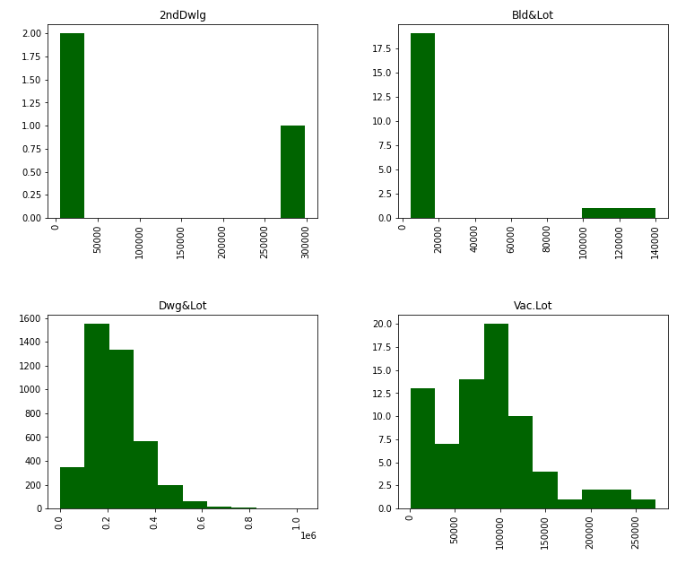
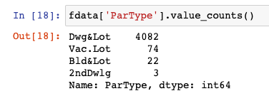
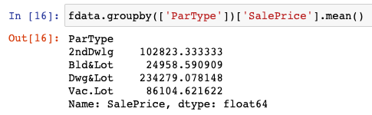
Outliers: (99 Observations)
MapRefNo | GeoRefNo | Tier | Range | Prop_Addr | ZngCdPr | ZngCdSc | ZngOLPR | ClassPr_s | Legal_pr
SchD_S | TxD_S | MA_Ownr1 | MA_Ownr2 | MA_Line1 | MA_Line2 | MA_City | MA_State | MA_Zip1 | MA_Zip2
Rcrd_Yr | Rcrd_Mo | Inst1_No | Inst1_Yr | Inst1_Mo | Inst1TPr | LndAc_S | ImpAc_S | OthAc_S | TtlVal_AsrYr
ValType | X1TPr_D | X1TSc_D | X2TPr_D | X2TSc_D | X1TPr_S | X1TSc_S | X2TPr_S | X2TSc_S | LndAcX1S
ImpAcX1S | ImpAcX2S | HSTtl_D | MilVal_D | HSTtl_S | MilVal_S | AcreX_S1 | AcreGr | AcreNt_S | Neighborhood
LotArea | ParType | BldgNo_S | DwlgNo_S | BldgType | YrBuilt | HouseStyle | Foundation | RoofMatl | Ext1
Ext2 | MasVnrType | Heating | Central Air | GLA | TtlBsmtSF | TotRmsAbvGrd | Fireplaces | PoolArea | GarageType
GarYrBlt | Cars | GarageArea | YrSold_YYYY | MoSold_MM | SalePrice | SaleType | SaleCond | ParclRel | PA-Nmbr
PA-PreD | PA-Strt | PA-StSfx | PA-PostD | PA-UnTyp | PA-UntNo | Date | Source | NmbrBRs | ClassSc_S
ZngOLSc

Slide 14
Cleaning & Preprocessing
General Rule: > 10%
Augment the Data
Exploratory Data Analysis
Explore the +- 2.5% Target Values
Train Test Split
The dataset has 4,181 observations (Homes sold within the past 18-24 months) and 92 features. The data dictionary provided by the city website was vital to understanding the features.
Eliminate features that have more than 10% missing values. Here all features that were eliminated by this had > 50% missing values
Add HPI: A quarterly index that measures that average price change in repeat sales or refinancing on the same properties
The goal is to reduce the feature space via 1. eliminating features that are not useful to predict target, and 2. Combining existing features that relate better to target.
Outliers
Data Leakage
Missing Values
Seasonal Adjustment
Feature Engineering
Eliminate observations that fall too far outside of the “middle” based on the distribution of the data (which is fairly normal).
Split the data at this point prior to examining correlations and trends.

Slide 15
Seasonal Adjustment: (1 New Feature)
MapRefNo | GeoRefNo | Tier | Range | Prop_Addr | ZngCdPr | ZngCdSc | ZngOLPR | ClassPr_s | Legal_pr
SchD_S | TxD_S | MA_Ownr1 | MA_Ownr2 | MA_Line1 | MA_Line2 | MA_City | MA_State | MA_Zip1 | MA_Zip2
Rcrd_Yr | Rcrd_Mo | Inst1_No | Inst1_Yr | Inst1_Mo | Inst1TPr | LndAc_S | ImpAc_S | OthAc_S | TtlVal_AsrYr
ValType | X1TPr_D | X1TSc_D | X2TPr_D | X2TSc_D | X1TPr_S | X1TSc_S | X2TPr_S | X2TSc_S | LndAcX1S
ImpAcX1S | ImpAcX2S | HSTtl_D | MilVal_D | HSTtl_S | MilVal_S | AcreX_S1 | AcreGr | AcreNt_S | Neighborhood
LotArea | ParType | BldgNo_S | DwlgNo_S | BldgType | YrBuilt | HouseStyle | Foundation | RoofMatl | Ext1
Ext2 | MasVnrType | Heating | Central Air | GLA | TtlBsmtSF | TotRmsAbvGrd | Fireplaces | PoolArea | GarageType
GarYrBlt | Cars | GarageArea | YrSold_YYYY | MoSold_MM | SalePrice | SaleType | SaleCond | ParclRel | PA-Nmbr
PA-PreD | PA-Strt | PA-StSfx | PA-PostD | PA-UnTyp | PA-UntNo | Date | Source | NmbrBRs | ClassSc_S
ZngOLSc | HPI

Slide 16
Cleaning & Preprocessing
General Rule: > 10%
Augment the Data
Exploratory Data Analysis
Explore the +- 2.5% Target Values
Train Test Split
The dataset has 4,181 observations (Homes sold within the past 18-24 months) and 92 features. The data dictionary provided by the city website was vital to understanding the features.
Eliminate features that have more than 10% missing values. Here all features that were eliminated by this had > 50% missing values
Add HPI: A quarterly index that measures that average price change in repeat sales or refinancing on the same properties
The goal is to reduce the feature space via 1. eliminating features that are not useful to predict target, and 2. Combining existing features that relate better to target.
Outliers
Data Leakage
Missing Values
Seasonal Adjustment
Feature Engineering
Eliminate observations that fall too far outside of the “middle” based on the distribution of the data (which is fairly normal).
Split the data at this point prior to examining correlations and trends.

Slide 17
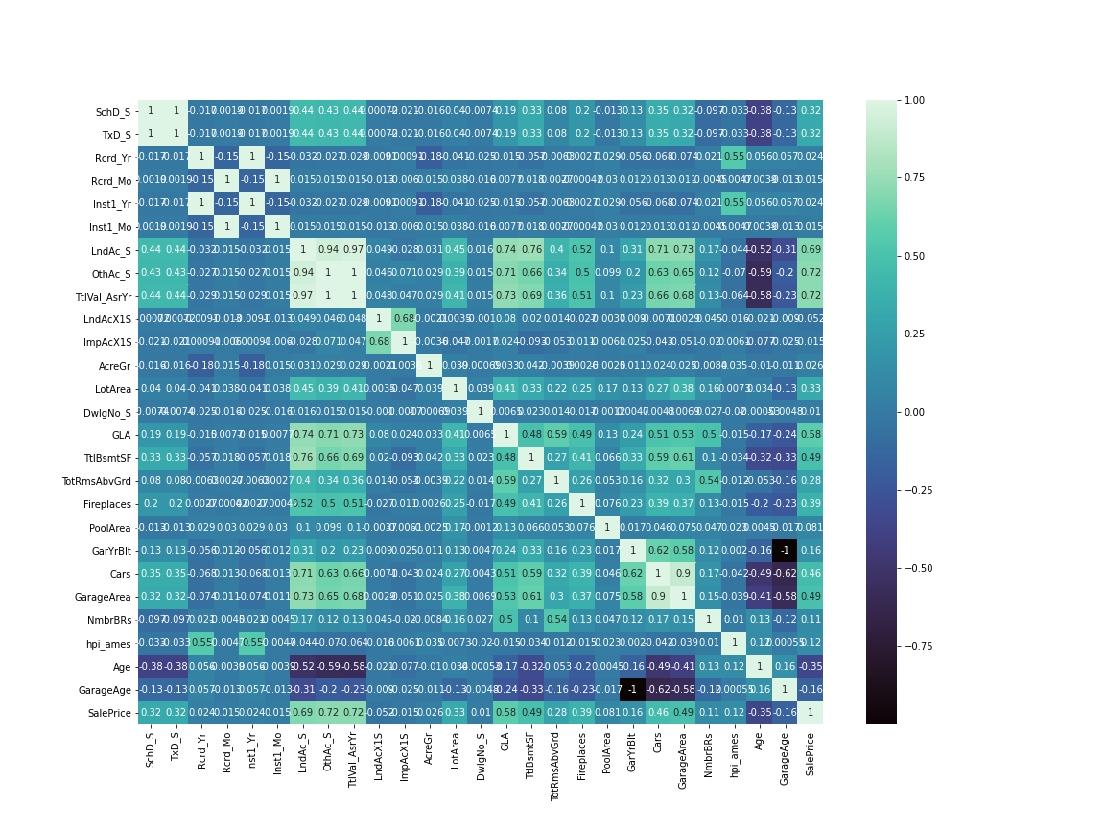
EDA & Feature Engineering: Numerical
Create Age & Garage Age: (-)
Multicollinearity: Does not affect performance (XGBoost) but definitely affects importance plot.
Cars & Garage Area
Assessed Value
School vs. Tax District
Identify Strong Predictors (abs() >.10)
HPI (low but necessary)

Slide 18
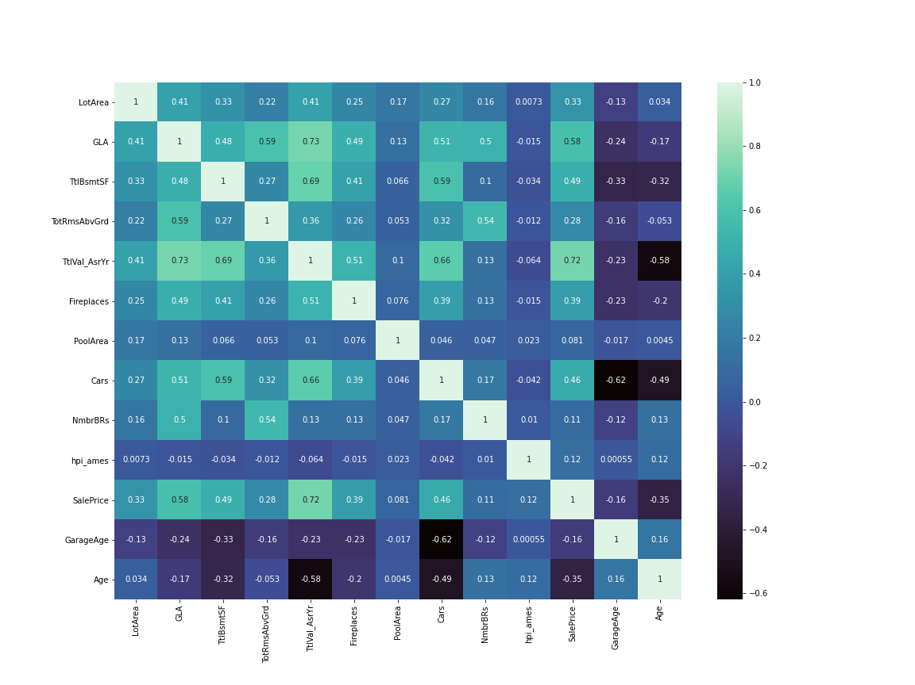
EDA & Feature Engineering: Numerical
Create Age & Garage Age: (-)
Multicollinearity: Does not affect performance (XGBoost) but definitely affects importance plot.
Cars & Garage Area
Assessed Value
School vs. Tax District
Identify Strong Predictors (abs() >.10)
HPI (low but necessary)
Note: SalePrice column is NOT at the end…

Slide 19
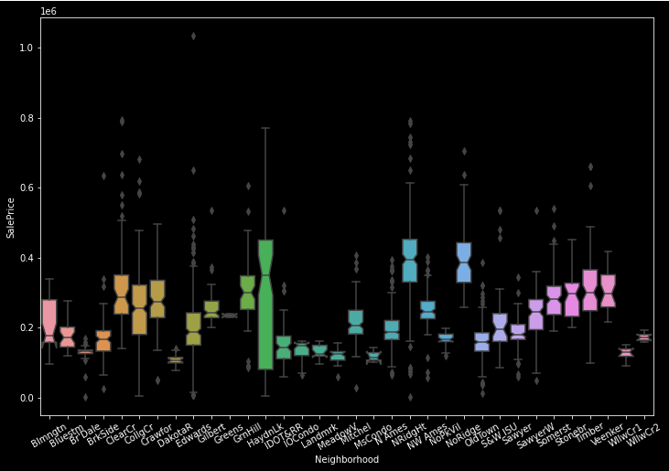
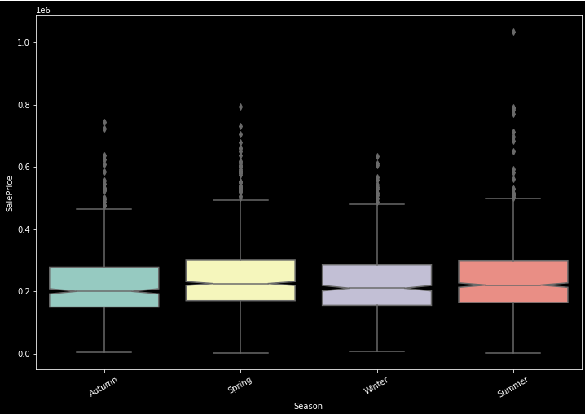
EDA & Feature Engineering: Categorical
Notched box-plot inspection usually serves as a good starting place for me. Eliminate features based on visual inspection or statistical test where the visual alone does not show good separation.

Slide 20
EDA: (28 Features | 3061 Observations (4082 Total))
MapRefNo | GeoRefNo | Tier | Range | Prop_Addr | ZngCdPr | ZngCdSc | ZngOLPR | ClassPr_s | Legal_pr
SchD_S | TxD_S | MA_Ownr1 | MA_Ownr2 | MA_Line1 | MA_Line2 | MA_City | MA_State | MA_Zip1 | MA_Zip2
Rcrd_Yr | Rcrd_Mo | Inst1_No | Inst1_Yr | Inst1_Mo | Inst1TPr | LndAc_S | ImpAc_S | OthAc_S | TtlVal_AsrYr
ValType | X1TPr_D | X1TSc_D | X2TPr_D | X2TSc_D | X1TPr_S | X1TSc_S | X2TPr_S | X2TSc_S | LndAcX1S
ImpAcX1S | ImpAcX2S | HSTtl_D | MilVal_D | HSTtl_S | MilVal_S | AcreX_S1 | AcreGr | AcreNt_S | Neighborhood
LotArea | ParType | BldgNo_S | DwlgNo_S | BldgType | YrBuilt | HouseStyle | Foundation | RoofMatl | Ext1
Ext2 | MasVnrType | Heating | Central Air | GLA | TtlBsmtSF | TotRmsAbvGrd | Fireplaces | PoolArea | GarageType
GarYrBlt | Cars | GarageArea | YrSold_YYYY | MoSold_MM | SalePrice | SaleType | SaleCond | ParclRel | PA-Nmbr
PA-PreD | PA-Strt | PA-StSfx | PA-PostD | PA-UnTyp | PA-UntNo | Date | Source | NmbrBRs | ClassSc_S
ZngOLSc | HPI | Age | GarageAge | Season

Slide 21
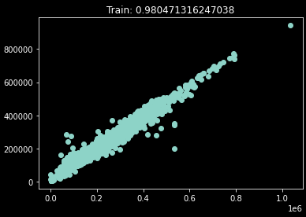
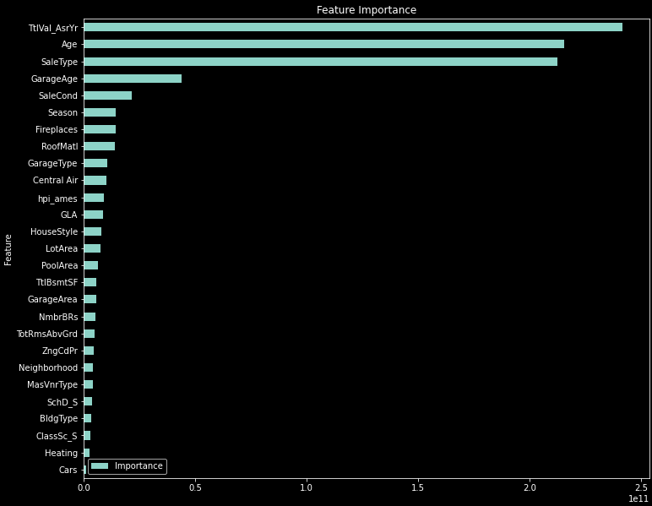
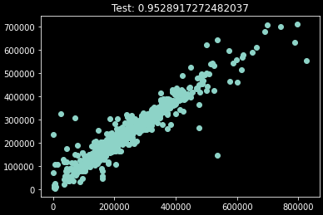
Model:
XGBoost: Great Performance
 | Train | Test
RMSE | 22,641.53 | 35,060.57
MAE | 14,860.41 | 19,971.07
 | CV Results | Notes
eta | .01 | Reduces overfitting
Objective | Squared Error | Outlier Penalty
n | 500 | Best Value

Slide 22
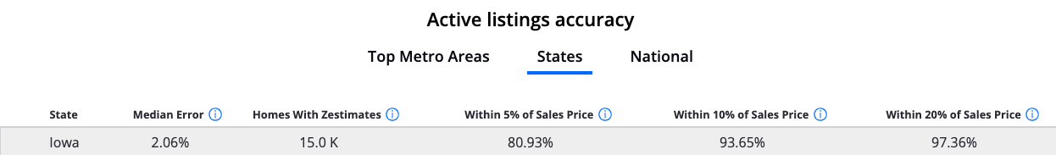
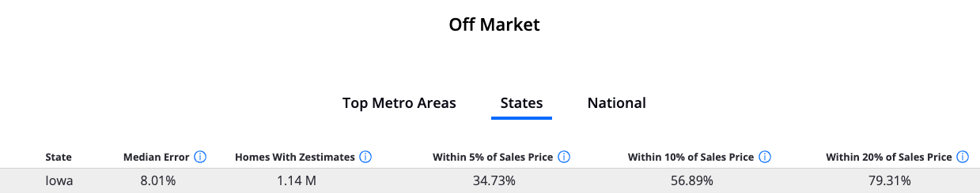
Model:
PVM Performance Metrics
 | Test | Description
PP10 | 70.5% | % predictions within 10% of true value
PP20 | 88.7% | % predictions within 20% of true value
PP30 | 6.37% | % predictions outside 30% of true value

Slide 23
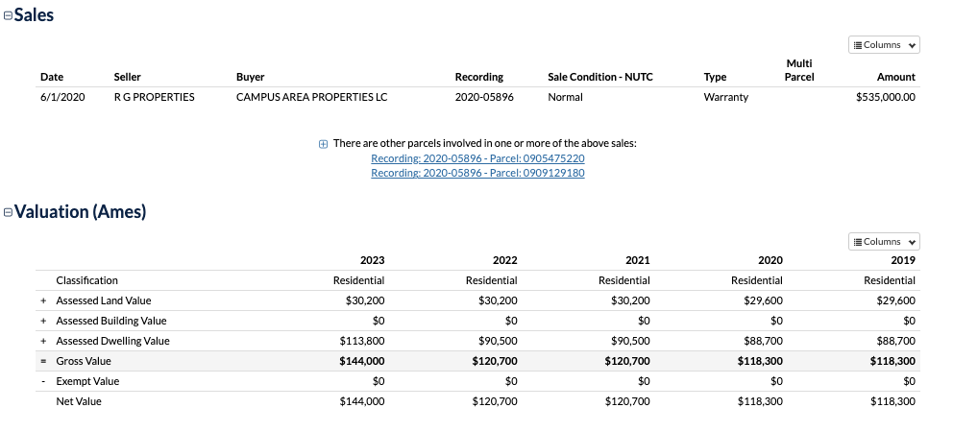
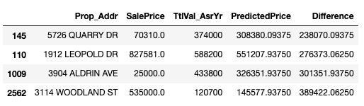
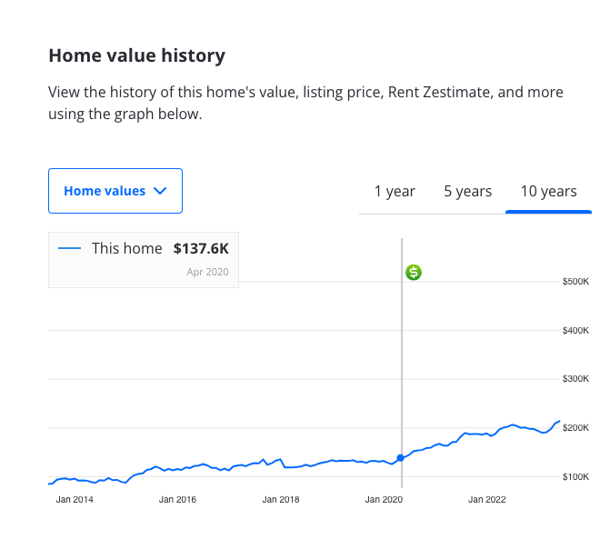
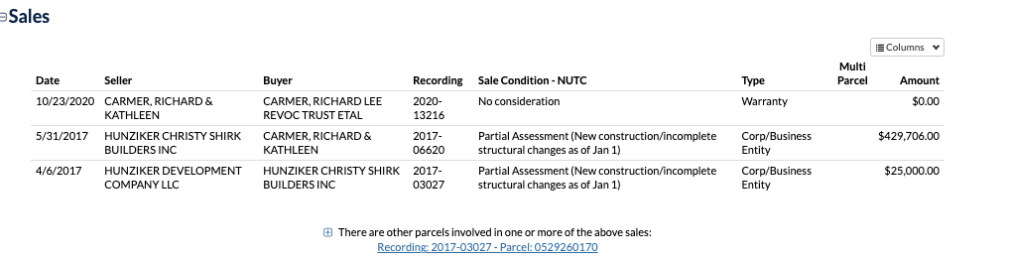
PP30…What happened here?

Slide 24
Next Steps
Iterate w/ better preprocessing
Time Series Analysis

Slide 25
Thank you.

